Slide 1
Learning from zero...
Some issues you might face
Laurence Moroney, Google

Slide 2
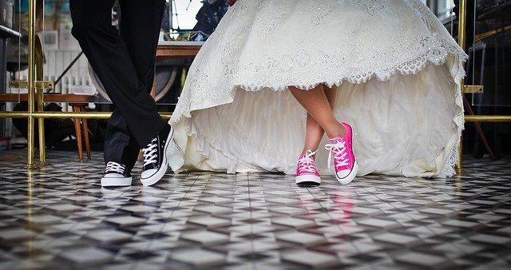
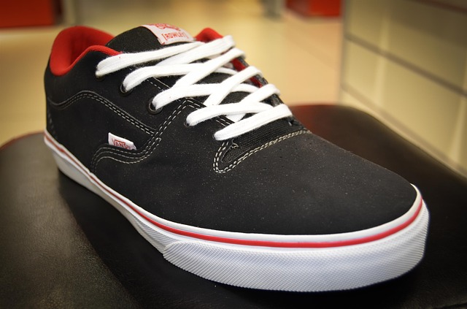
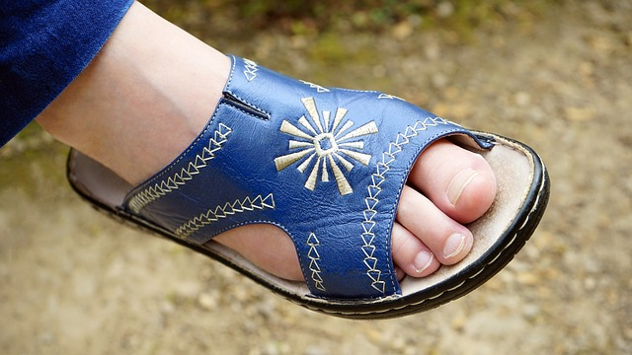

Notes:
All images cc0 from pixabay
https://pixabay.com/photos/foot-shoe-woman-feet-female-blue-1560814/
https://pixabay.com/photos/shoes-laces-shop-shopping-shelf-428606/
https://pixabay.com/photos/marriage-bridal-wedding-shoes-636018/
https://pixabay.com/photos/alone-feet-shoes-laces-sneakers-1869914/

Slide 3
Steps to take
Get as many examples of shoes as possible
Train using these examples
Profit!

Slide 4
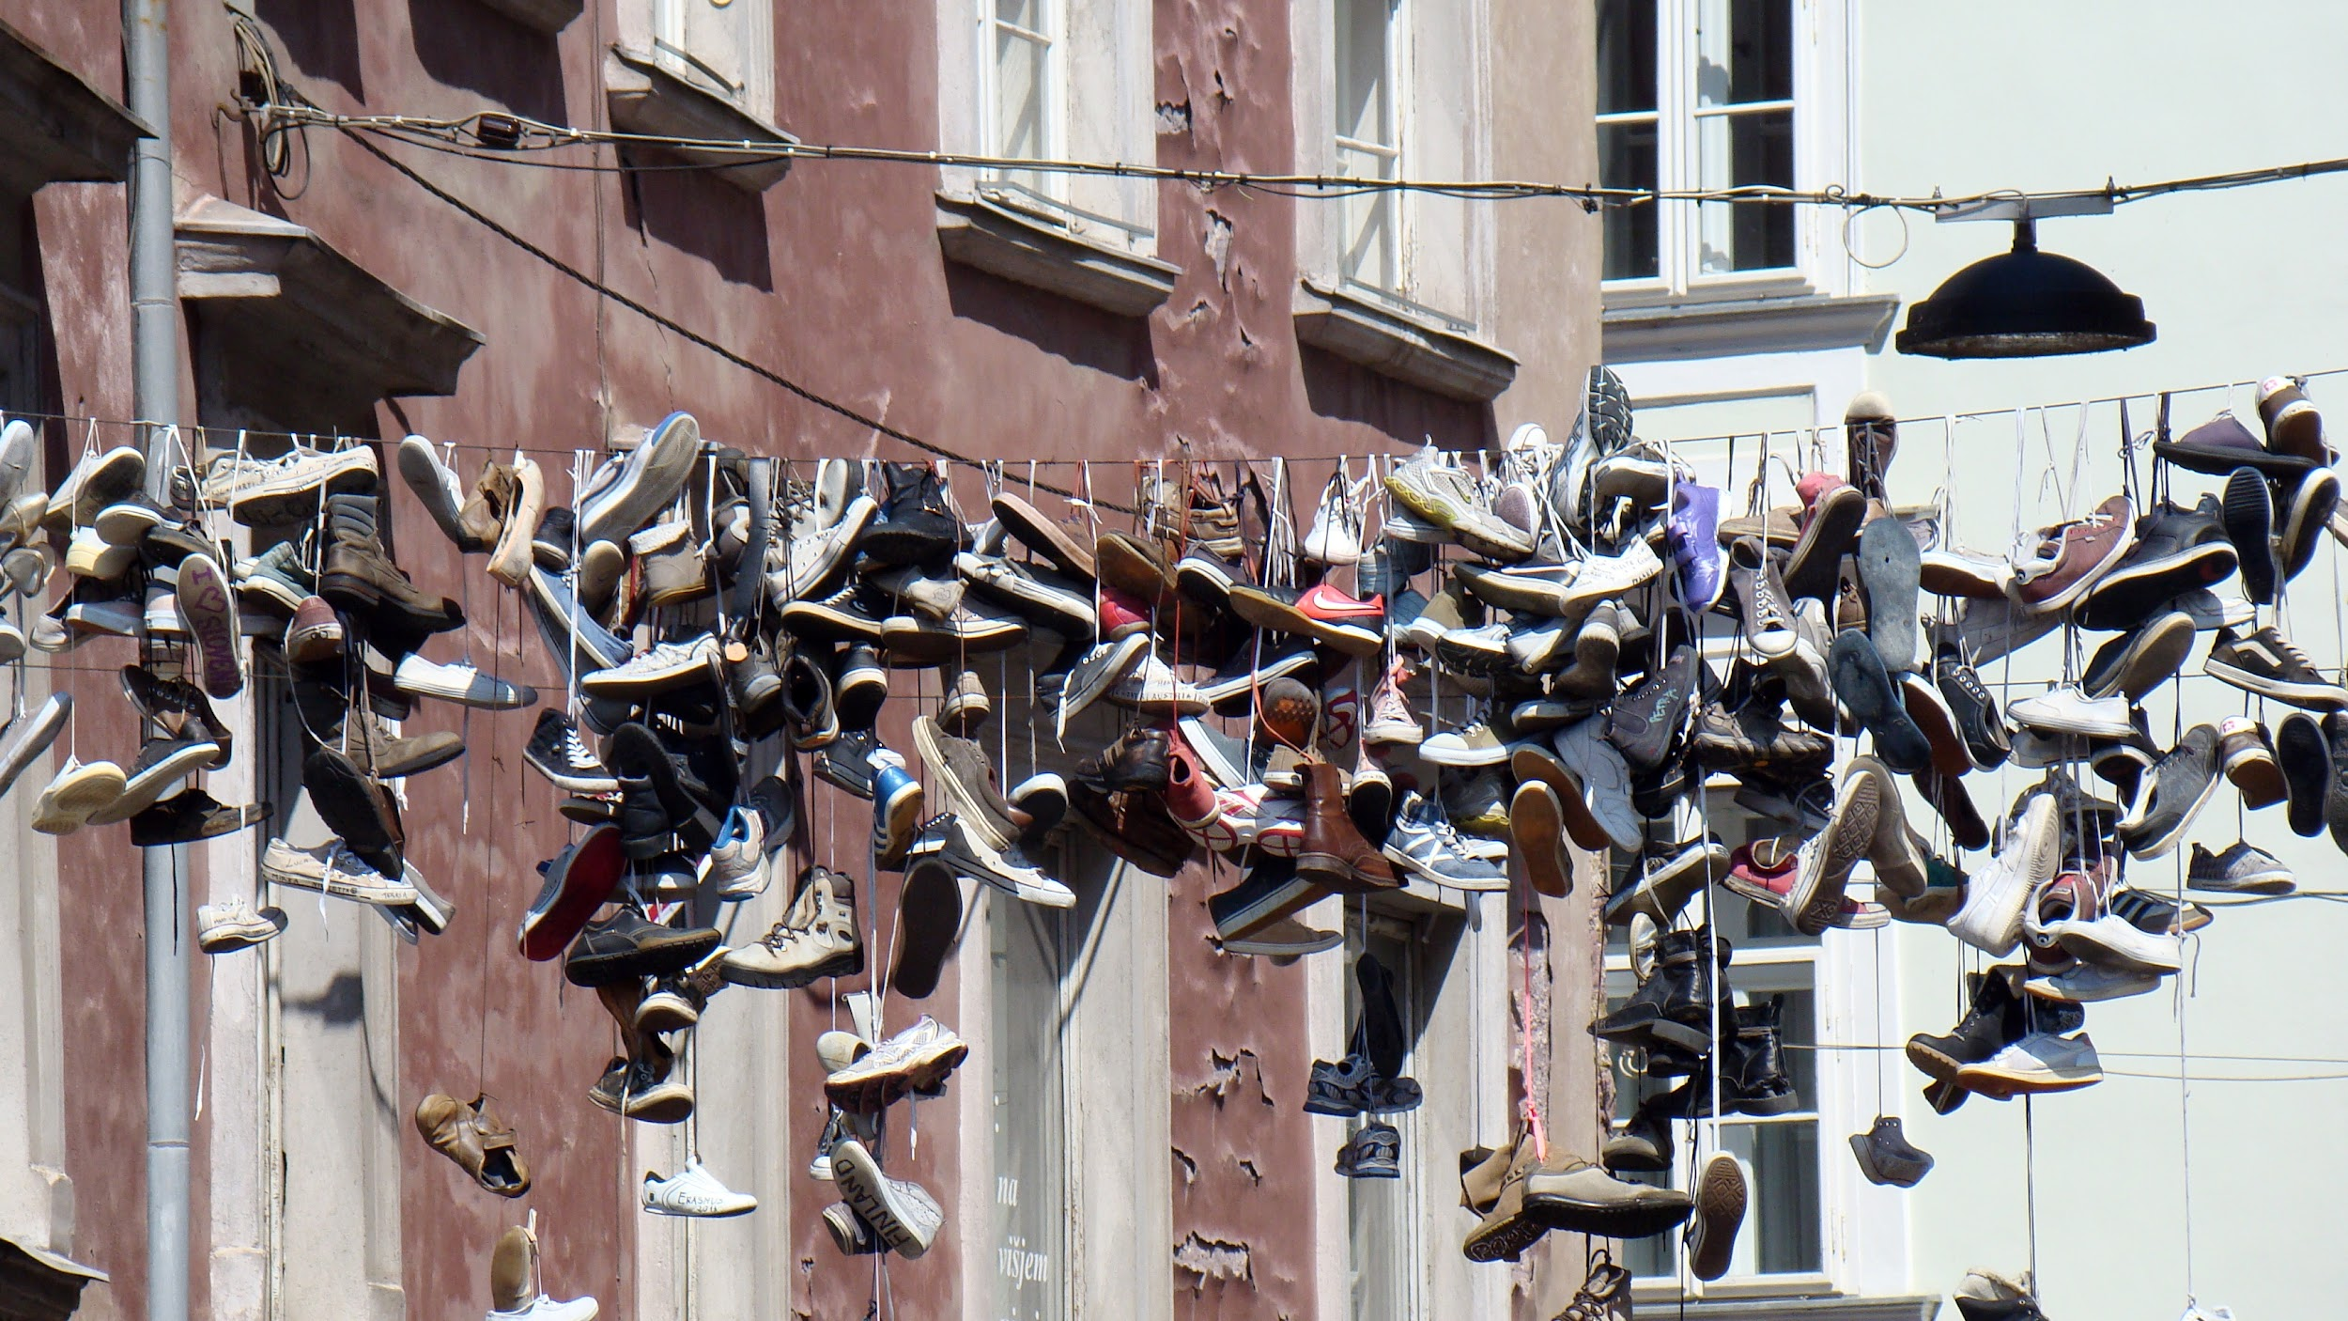
Notes:
https://pixabay.com/photos/shoes-a-lot-of-shoes-fastening-shoes-2583084/#_=_

Slide 5
Steps to take
Training accuracy: .920
Training accuracy: .935
Training accuracy: .947
Training accuracy: .961
Training accuracy: .977
Training accuracy: .995
Training accuracy: 1.00
Get as many examples of shoes as possible
Train using these examples
Profit!

Slide 6
Steps to take
Training accuracy: .920
Training accuracy: .935
Training accuracy: .947
Training accuracy: .961
Training accuracy: .977
Training accuracy: .995
Training accuracy: 1.00
Get as many examples of shoes as possible
Train using these examples
Profit!

Slide 7
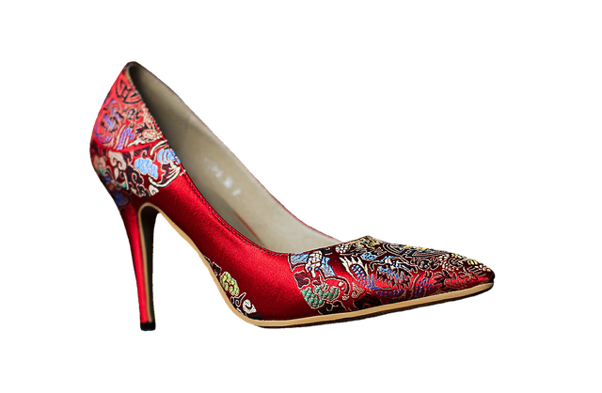
Steps to take
Get as many examples of shoes as possible
Train using these examples
Profit?
Notes:
https://pixabay.com/photos/high-heeled-shoes-pumps-2781084/

Slide 8
Data
The network ‘sees’ everything. Has no context for measuring how well it does with data it has never previously been exposed to.

Slide 9
Data
Validation Data
The network ‘sees’ a subset of your data. You can use the rest to measure its performance against previously unseen data.

Slide 10
Data
Validation Data
Test Data
The network ‘sees’ a subset of your data. You can use an unseen subset to measure its accuracy while training (validation), and then another subset to measure its accuracy after it’s finished training (test).

Slide 11
Data
Validation Data
Test Data
Accuracy: 0.999
Accuracy: 0.920
Accuracy: 0.800

Slide 12
Data
Validation Data
Test Data
Accuracy: 0.999
Accuracy: 0.920
Accuracy: 0.800

Slide 13
Data
Validation Data
Test Data
Accuracy: 0.942
Accuracy: 0.930
Accuracy: 0.925

Slide 14
import tensorflow as tf
data = tf.keras.datasets.mnist
(training_images, training_labels), (val_images, val_labels) = data.load_data()
training_images = training_images / 255.0
val_images = val_images / 255.0
model = tf.keras.models.Sequential(
[tf.keras.layers.Flatten(input_shape=(28,28)),
tf.keras.layers.Dense(20, activation=tf.nn.relu),
tf.keras.layers.Dense(10, activation=tf.nn.softmax)])

Slide 15
import tensorflow as tf
data = tf.keras.datasets.mnist
(training_images, training_labels), (val_images, val_labels) = data.load_data()
training_images = training_images / 255.0
val_images = val_images / 255.0
model = tf.keras.models.Sequential(
[tf.keras.layers.Flatten(input_shape=(28,28)),
tf.keras.layers.Dense(20, activation=tf.nn.relu),
tf.keras.layers.Dense(10, activation=tf.nn.softmax)])

Slide 16
model.fit(training_images, training_labels, epochs=20)

Slide 17
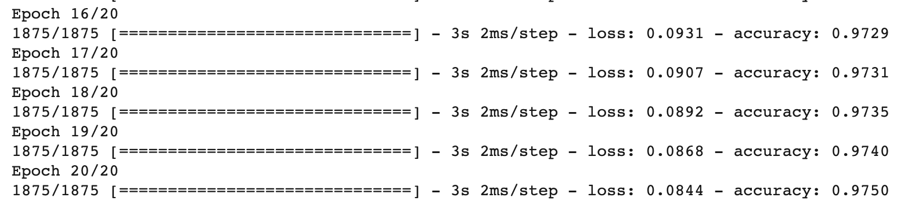
model.fit(training_images, training_labels, epochs=20)

Slide 18
model.fit(training_images, training_labels, epochs=20)

Slide 19
model.fit(training_images, training_labels,
validation_data=(val_images, val_labels),
epochs=20)

Slide 20
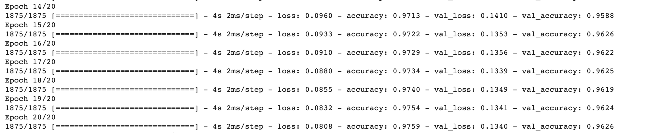
model.fit(training_images, training_labels,
validation_data=(val_images, val_labels),
epochs=20)

Slide 21
model.fit(training_images, training_labels,
validation_data=(val_images, val_labels),
epochs=20)

Slide 22
model.evaluate(test_images, test_labels)

Slide 23
model.evaluate(test_images, test_labels)

Slide 24
Quiz!

